Slide 1
Recommendation System for Anime Data
Yok Moontep
Aom Pongpiriyakarn Simon Liaowongphuthorn

Slide 2

Why Recommendation System?
Buy better products for you
Less time deciding

Slide 3
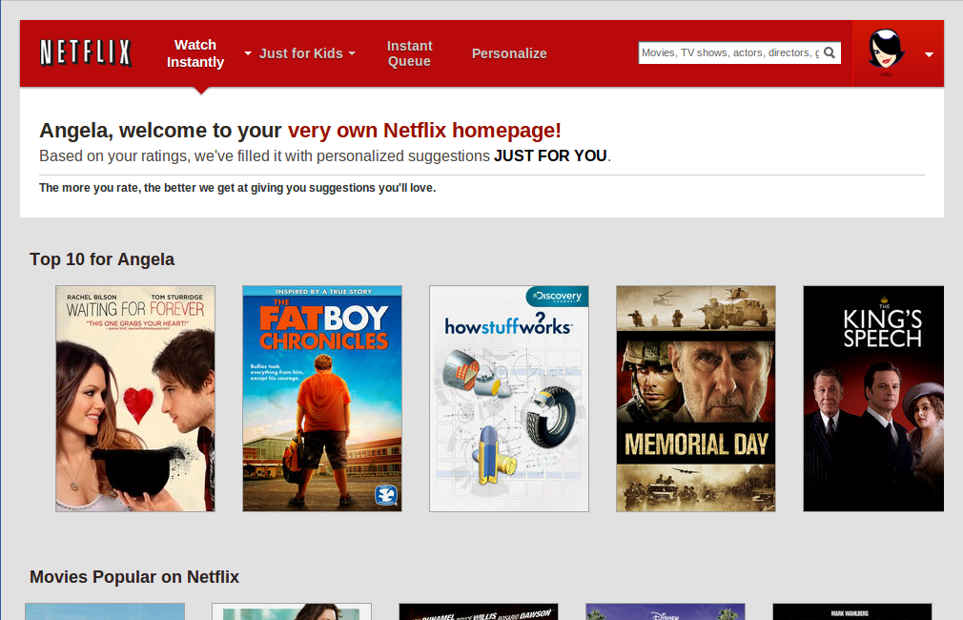
What is Recommendation System?
Predict user responses
Filter useful stuffs from big data
Learn customer choices and gives interest outcomes

Slide 4
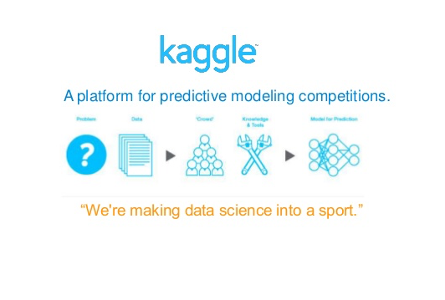
Kaggle
Online community for data scientists
Find and publish data sets
Explore and build models

Slide 5
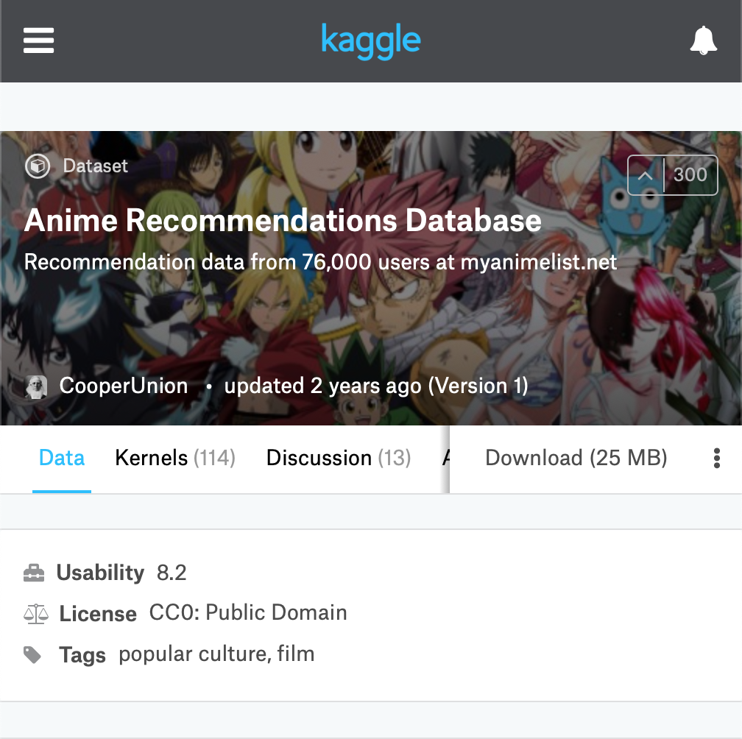
Anime Dataset
73,516 users, 12,294 anime
~4 millions entries
Rating: -1 to 10

Slide 6
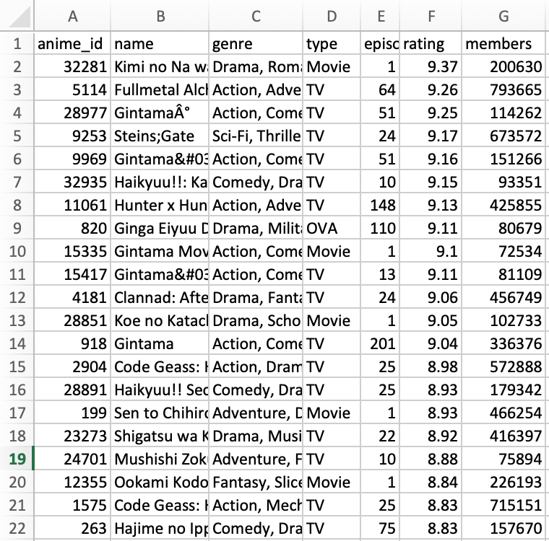
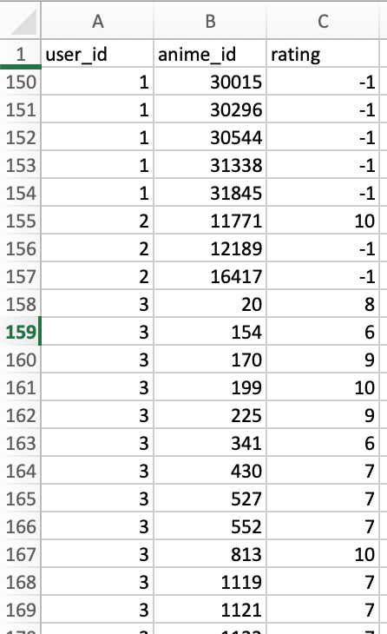
Anime Dataset
Anime.csv
Anime Id
Name
Genre
Type
Episodes
Rating
members
Rating.csv
User Id
Anime id
Rating

Slide 7

Data Visualization - Tableau
Interactive data visualization software

Slide 8
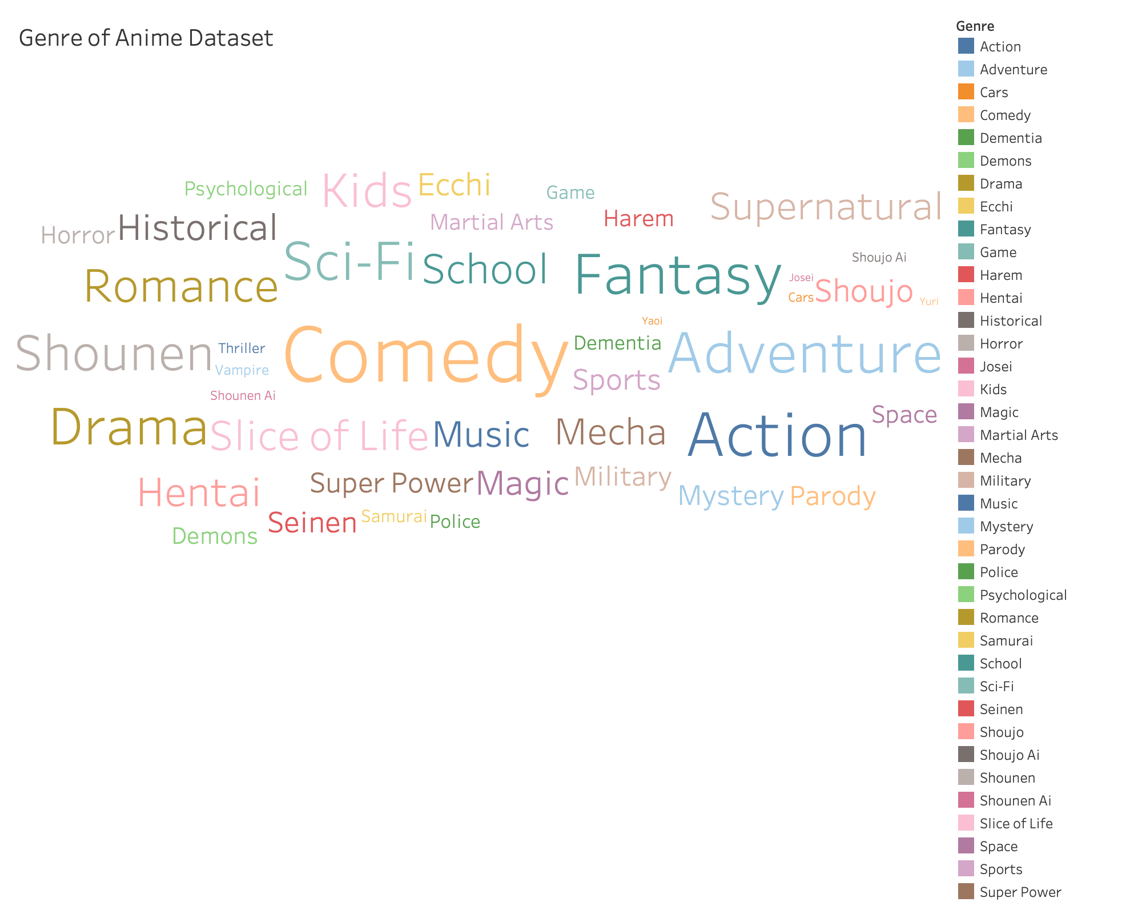

Slide 9
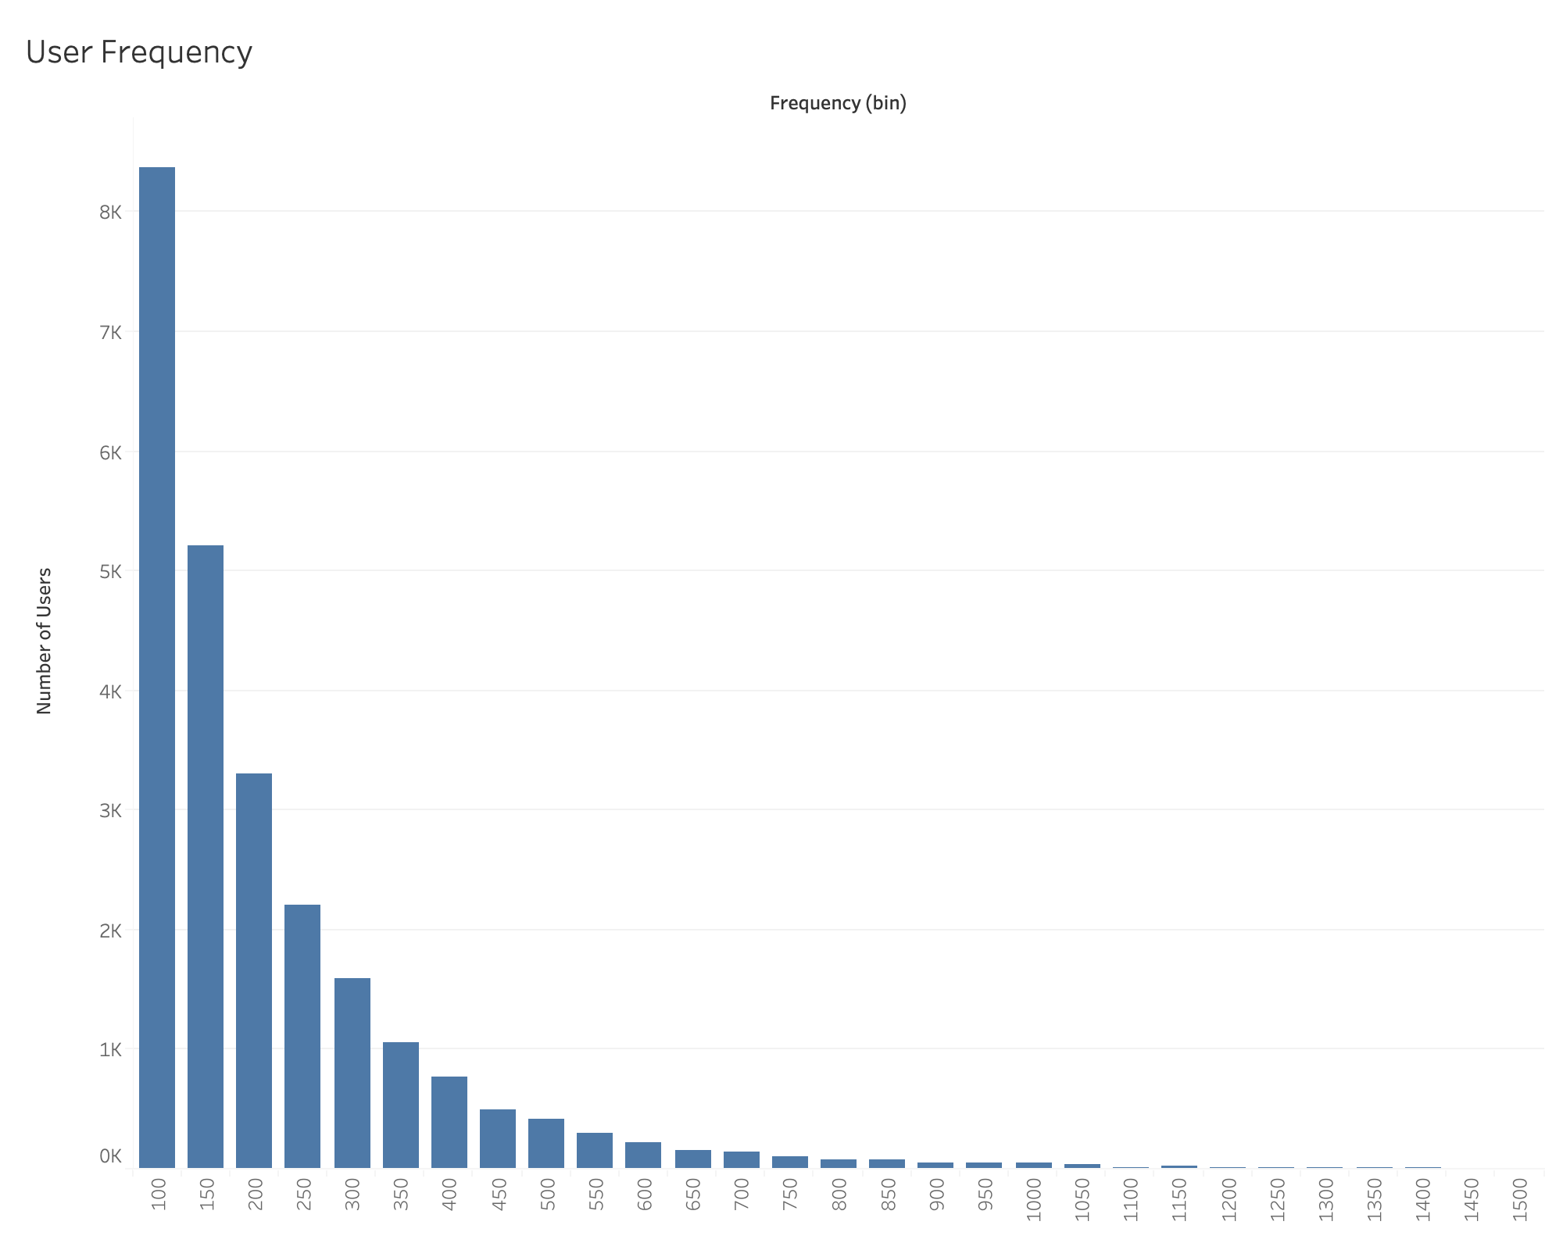

Slide 10
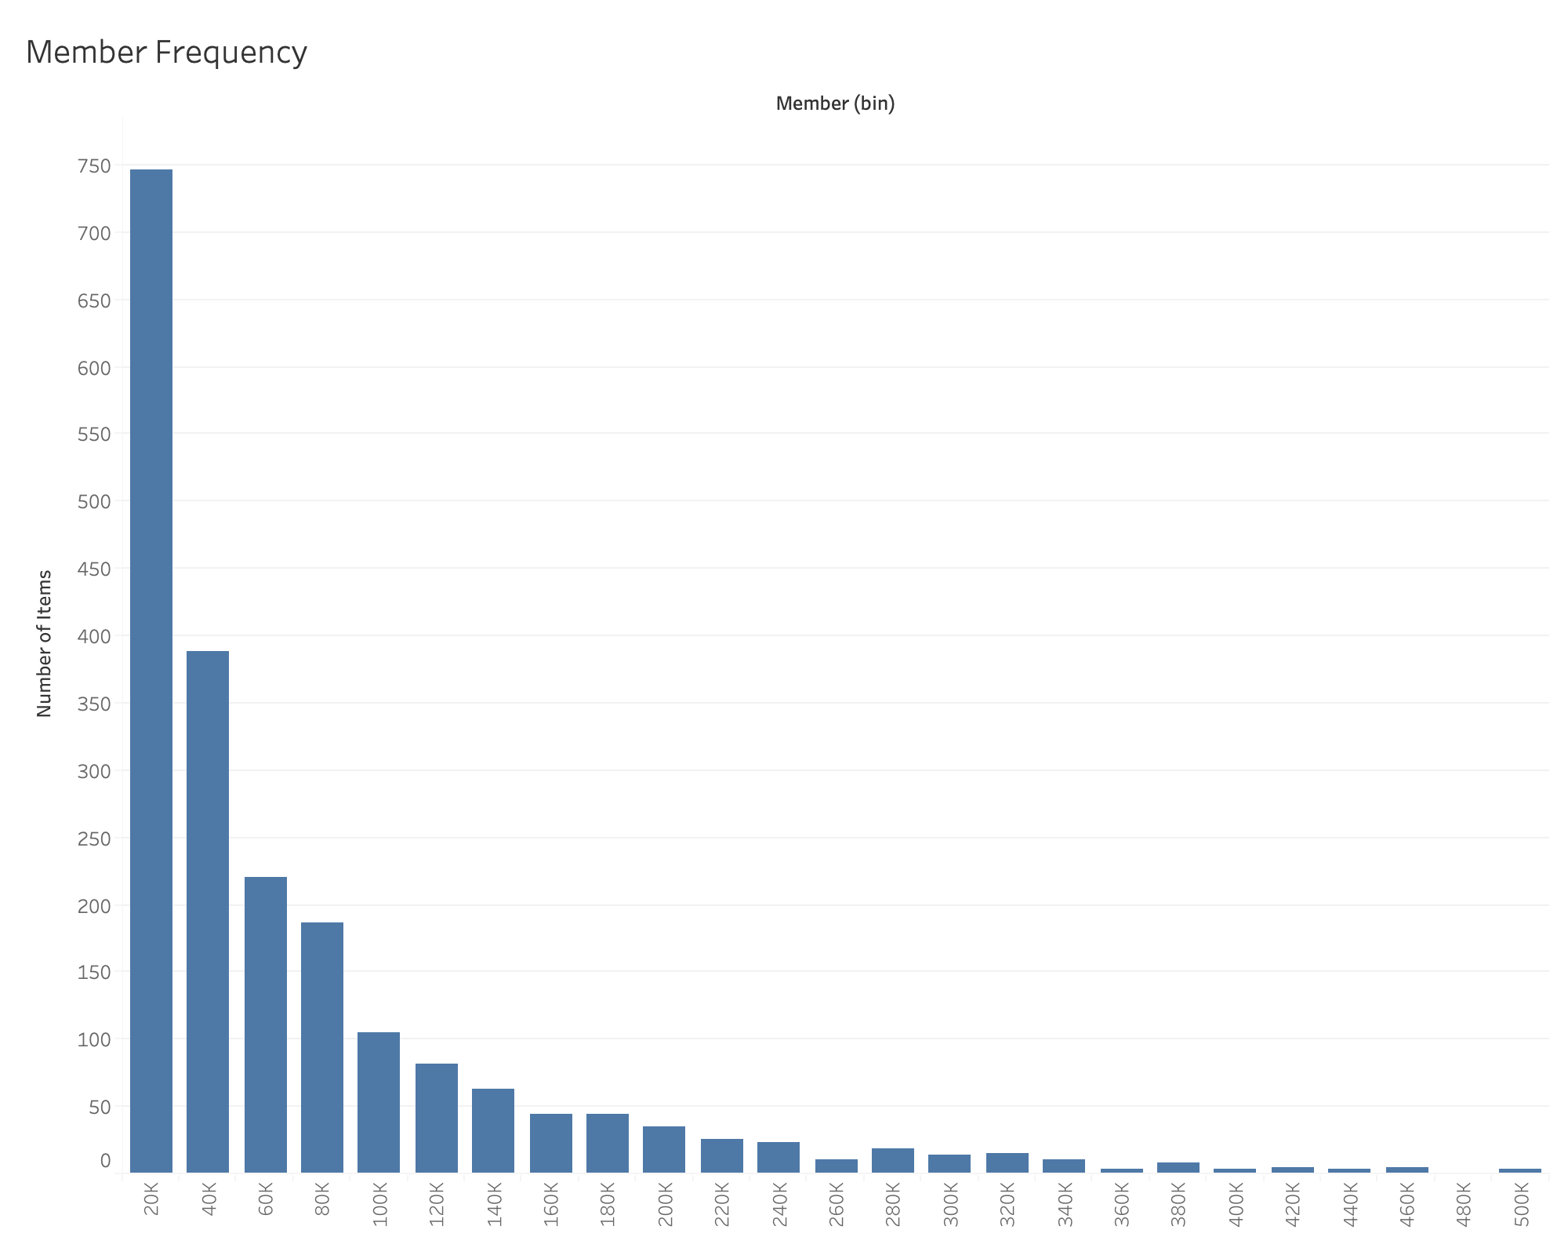

Slide 11
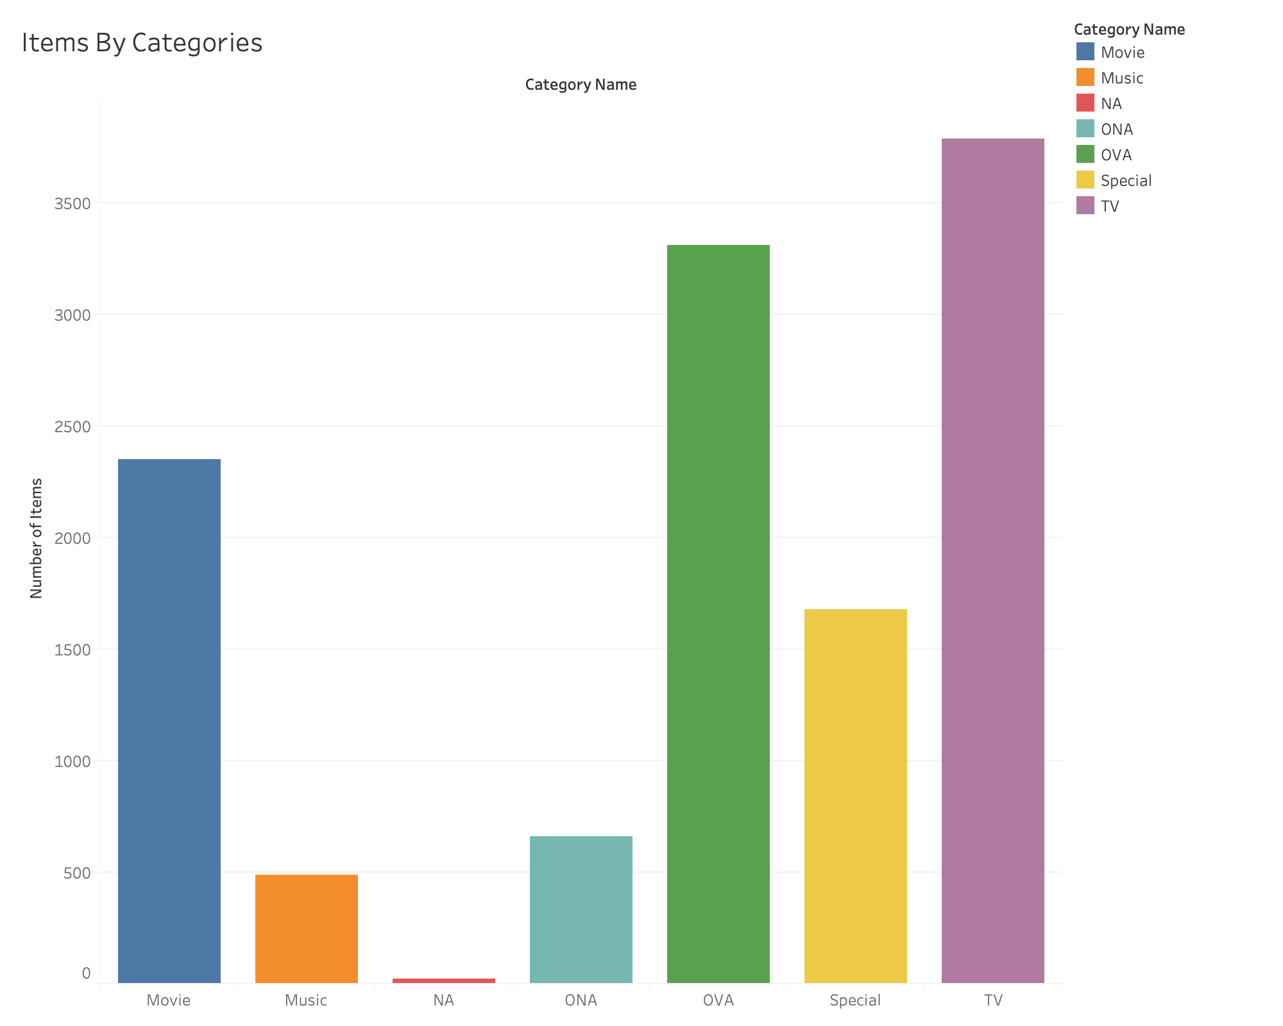

Slide 12
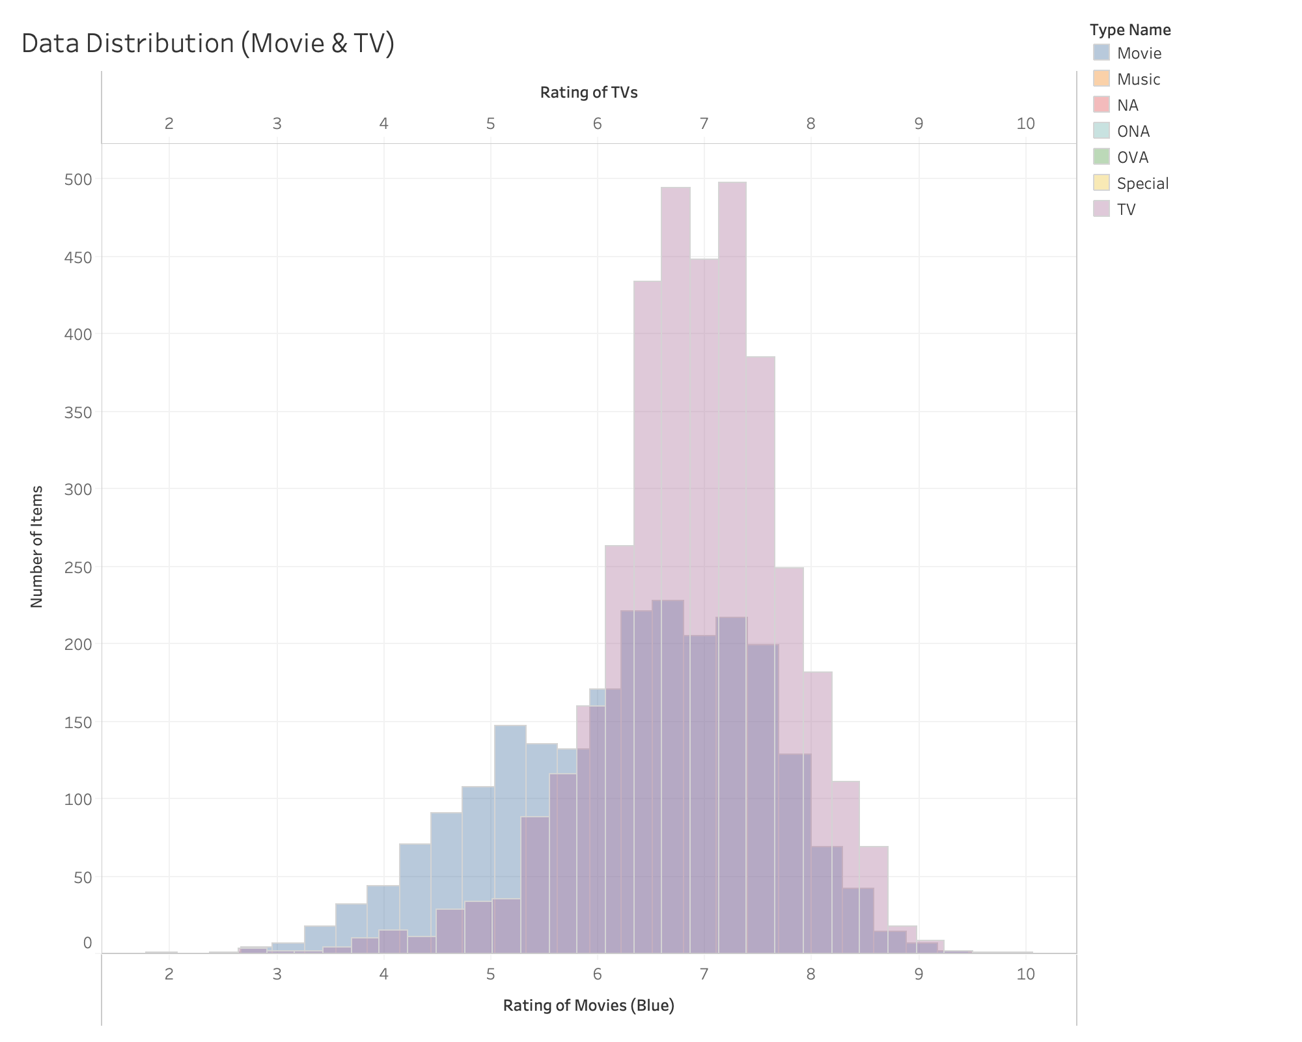

Slide 13
Clustering
Principal Component Analysis
K Mean Clustering
Cluster Characteristic

Slide 14
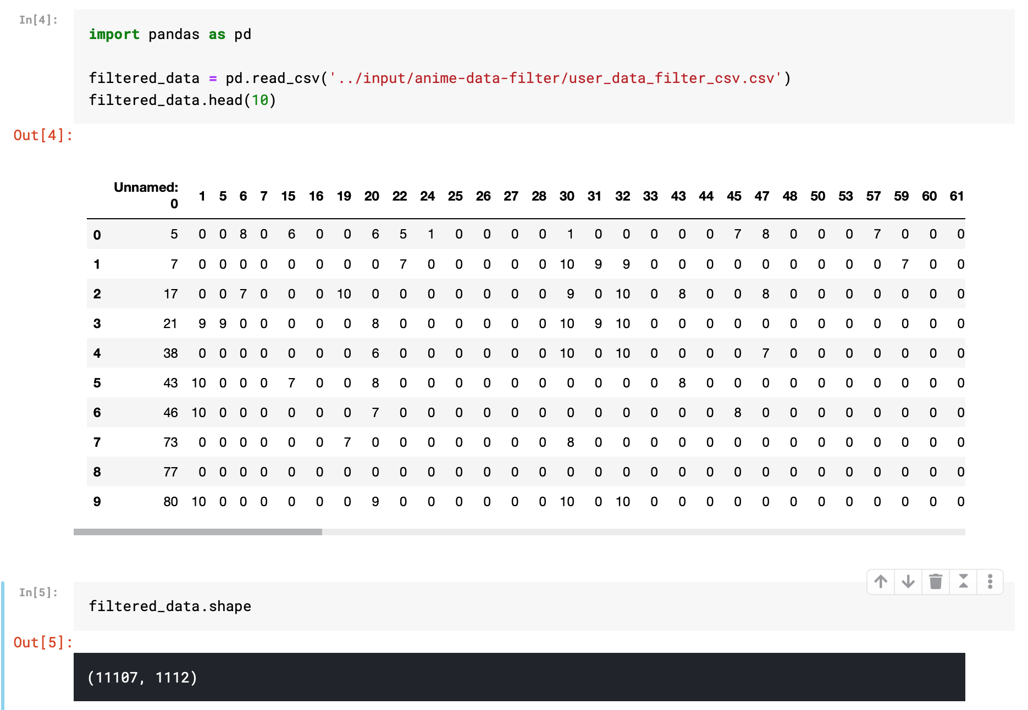

Slide 15
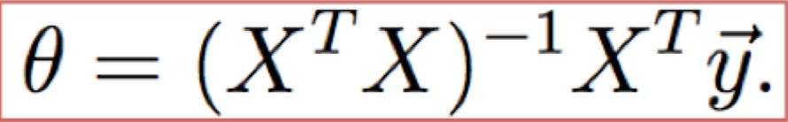
Principal Component Analysis
Convert to a new set of linear combination (principal components; PCs) of original variables
Reduce dimensions of data for clustering and visualization
main steps
Create new d dimensional data set of d+1 dimensions
Compute mean, covariance matrix, eigenvectors and eigenvalues
Sort and choose k eigenvectors with largest eigenvalues
Use result to transform samples onto new subspace

Slide 16
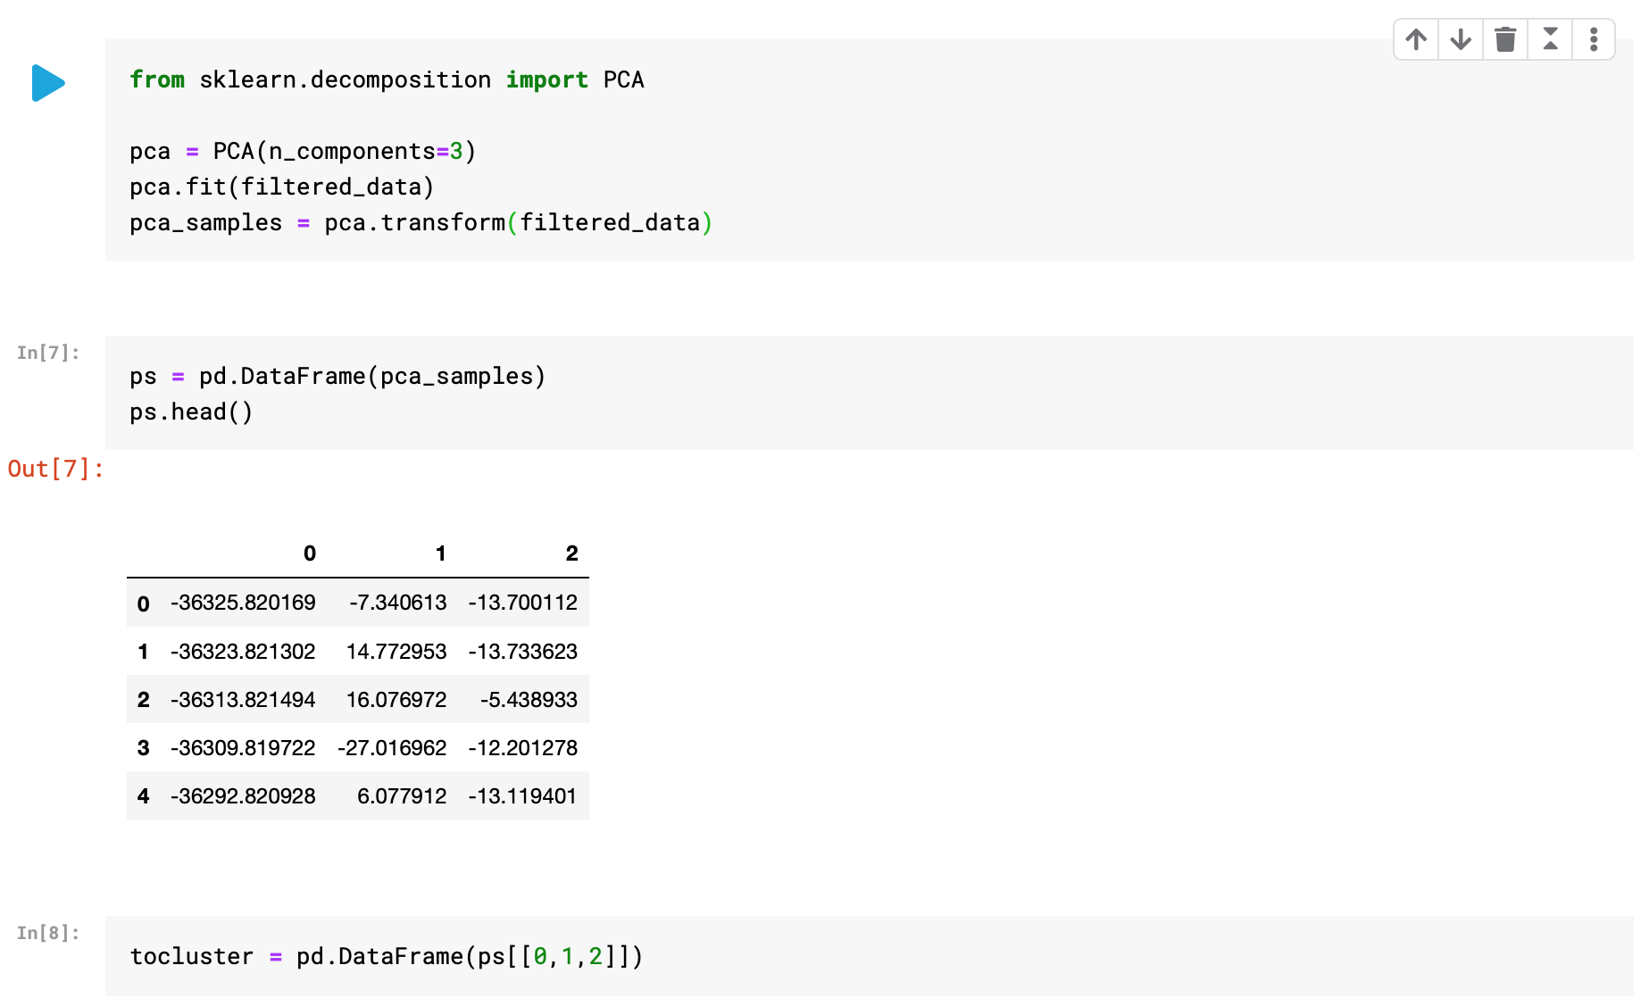

Slide 17
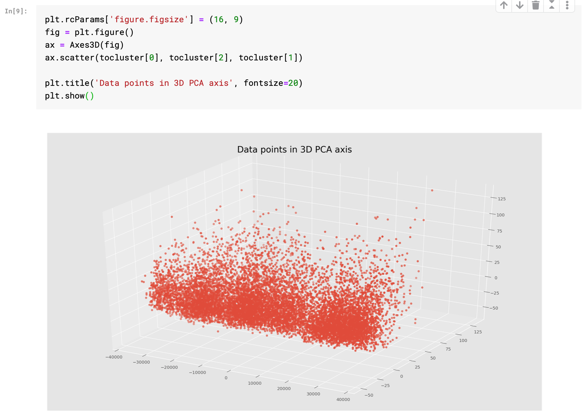

Slide 18
K Mean Clustering
Partition n observations into k clusters
For all n_i belongs to a k_j with nearest mean

Slide 19
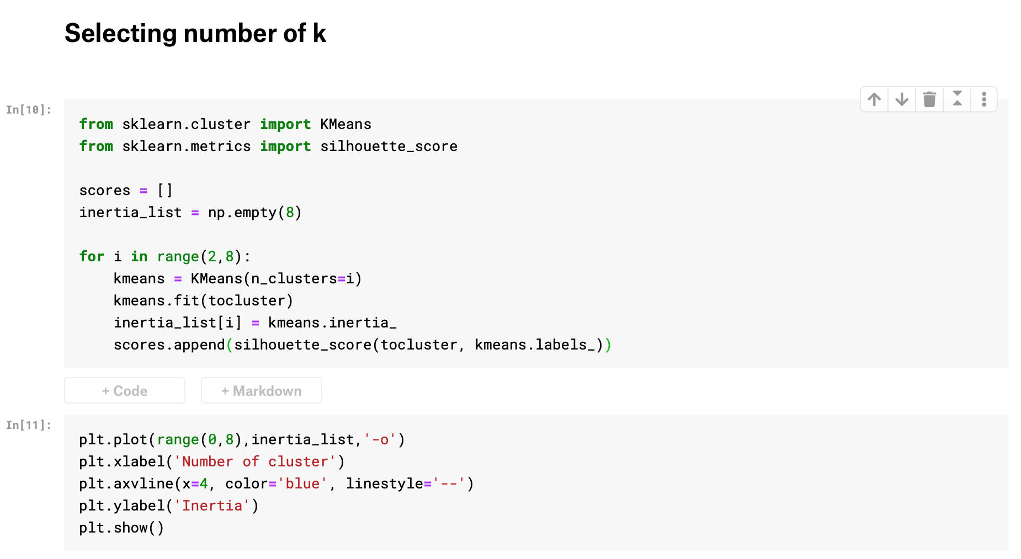

Slide 20
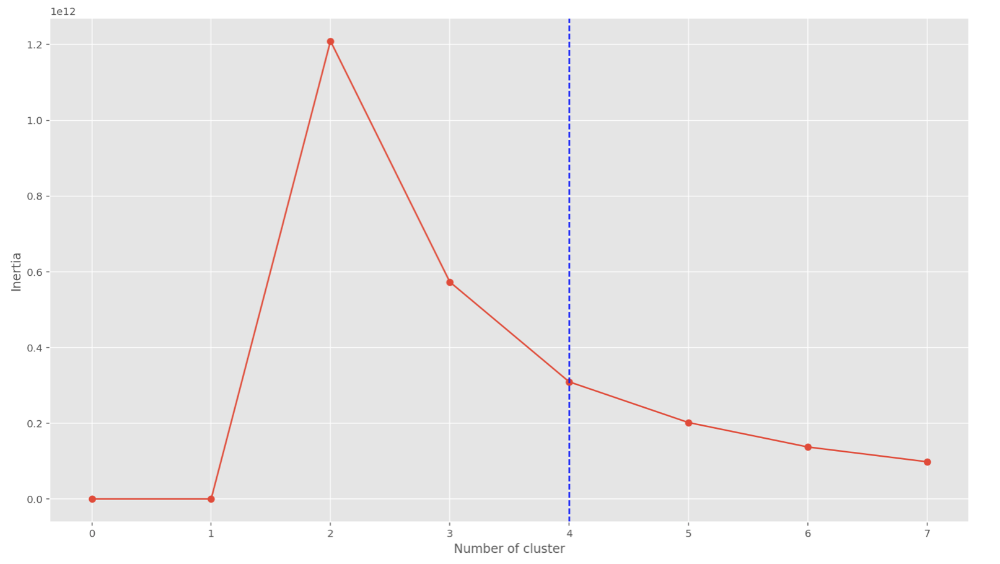

Slide 21
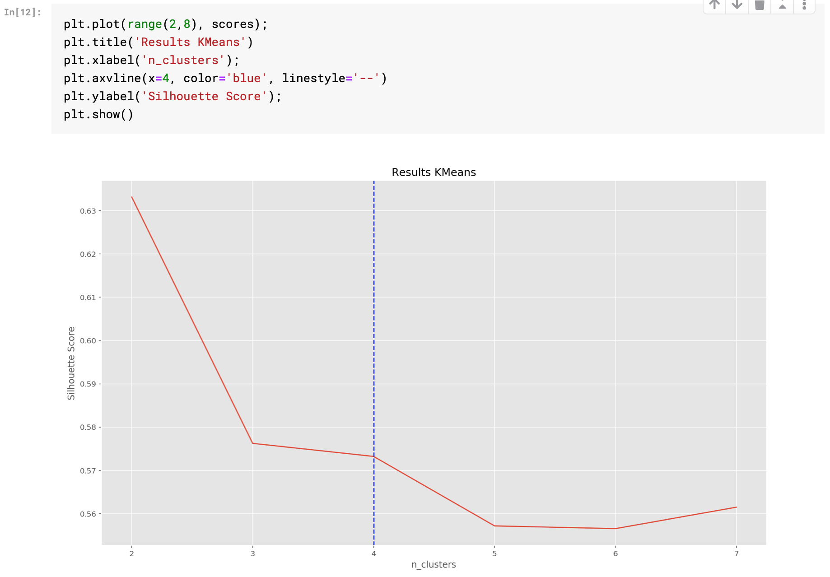

Slide 22
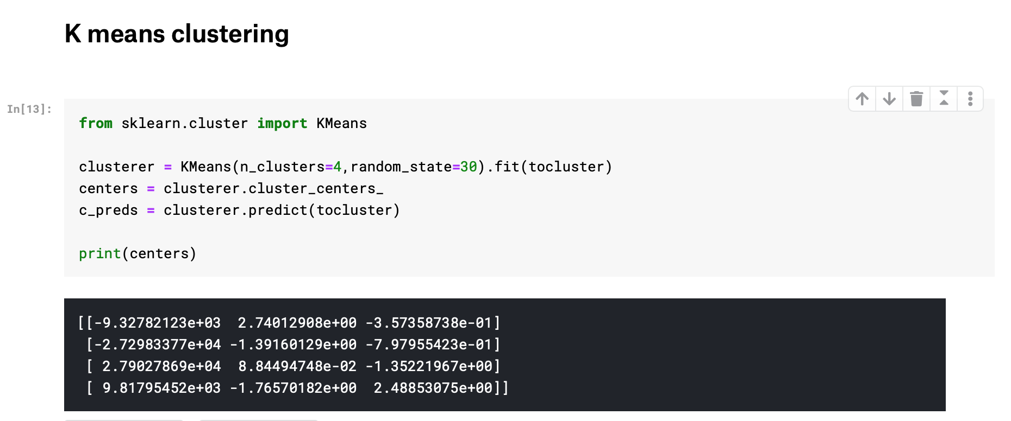
Characteristics of Clustering

Slide 23
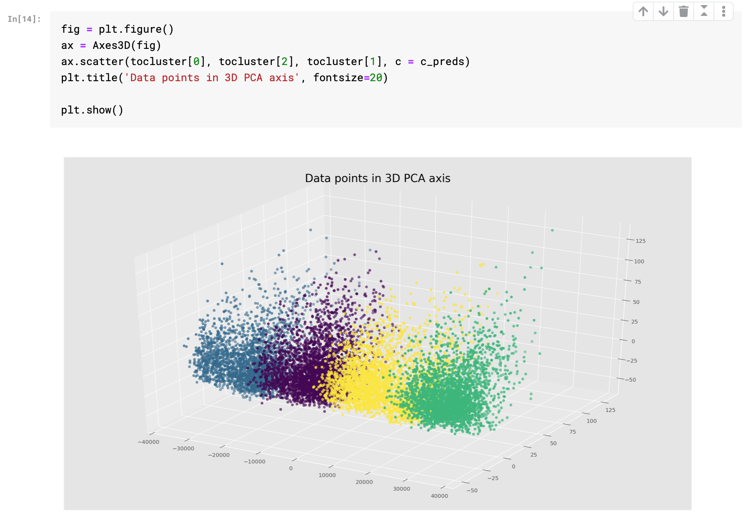

Slide 24
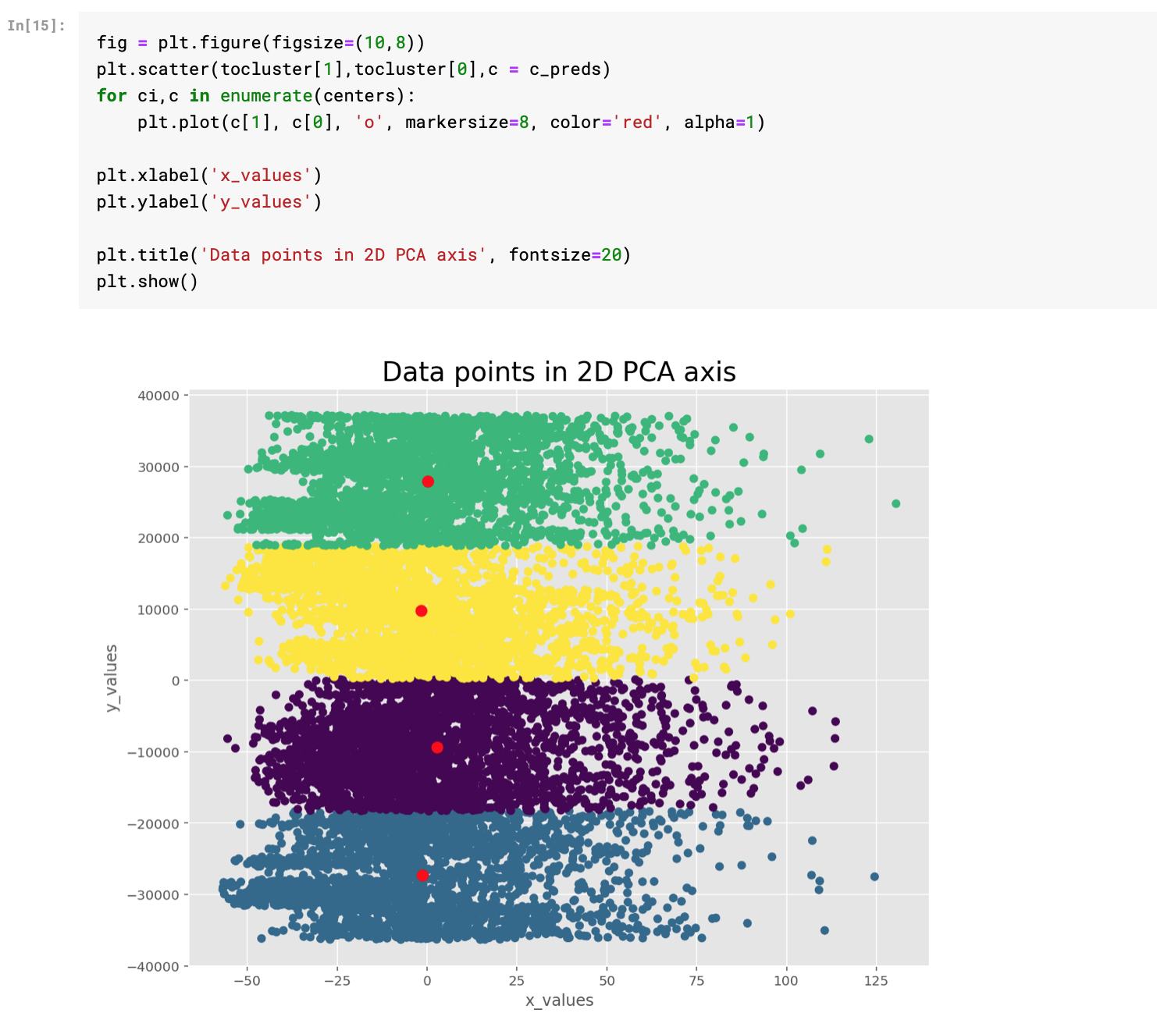

Slide 25
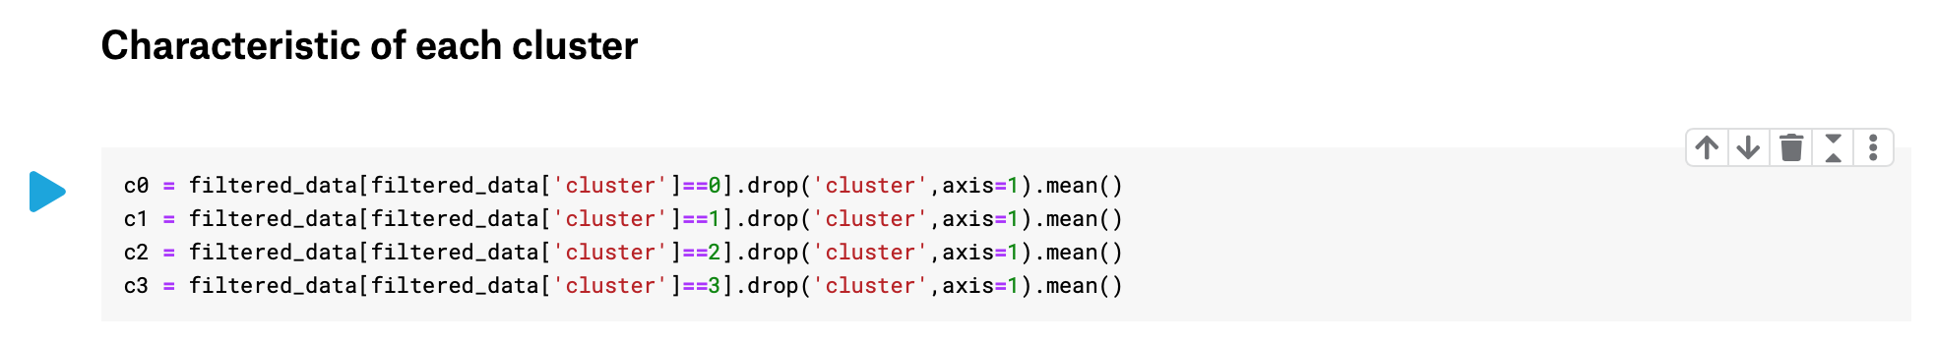

Slide 26




Cluster Characteristics

Slide 27
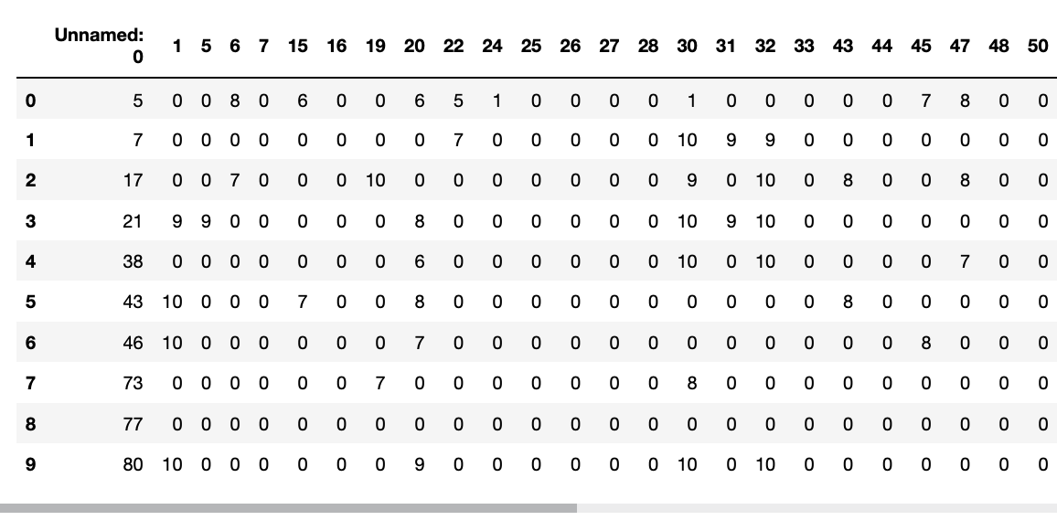
Goal
Predict user’s rating using collaborative filtering
Compare accuracy and performance of different algorithms

Slide 28
Collaborative Filtering Model
Matrix Factorization
SVD/SVD++
NMF
Co Clustering
Nearest Neighbor
Slope One
Baseline
Normal predictor

Slide 29
Surprise Library (Simple Python RecommendatIon System Engine.)
A library developed from scikit which is scientific library
Contains helpful function for building recommender system
Model of recommending system
SVD
NMF
Baseline
etc.
Validation
Cross-validation
Evaluate
Etc.

Slide 30
Validation
K-Cross validation
Test set
Training sets

Slide 31

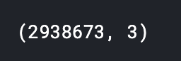
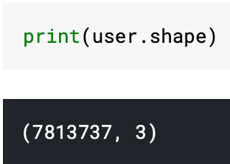
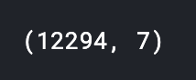
Clean Data
Target format
Database format
rating.csv
anime.csv

Slide 32
Cleaning criteria
Rating.csv
Entries of user who rate less than 130 animes
Entries of user watch but didn’t vote
Anime.csv
Anime which is not popular (anime with “member” less than 50000)

Slide 33
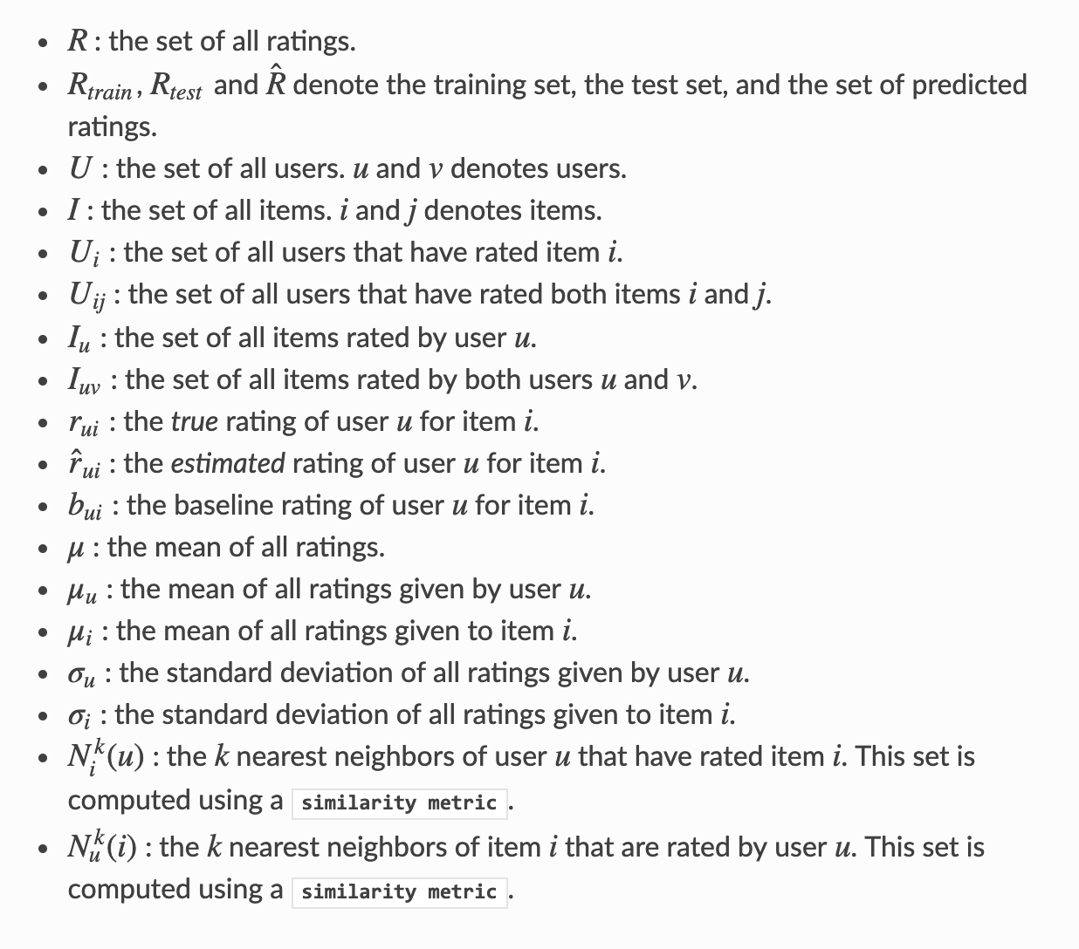
Notation

Slide 34
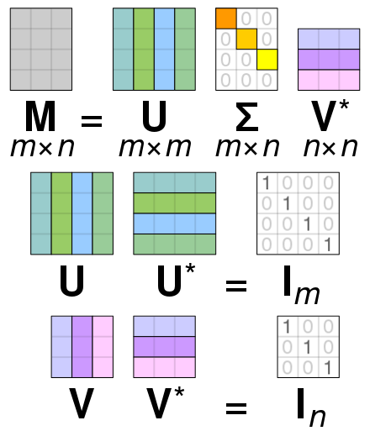
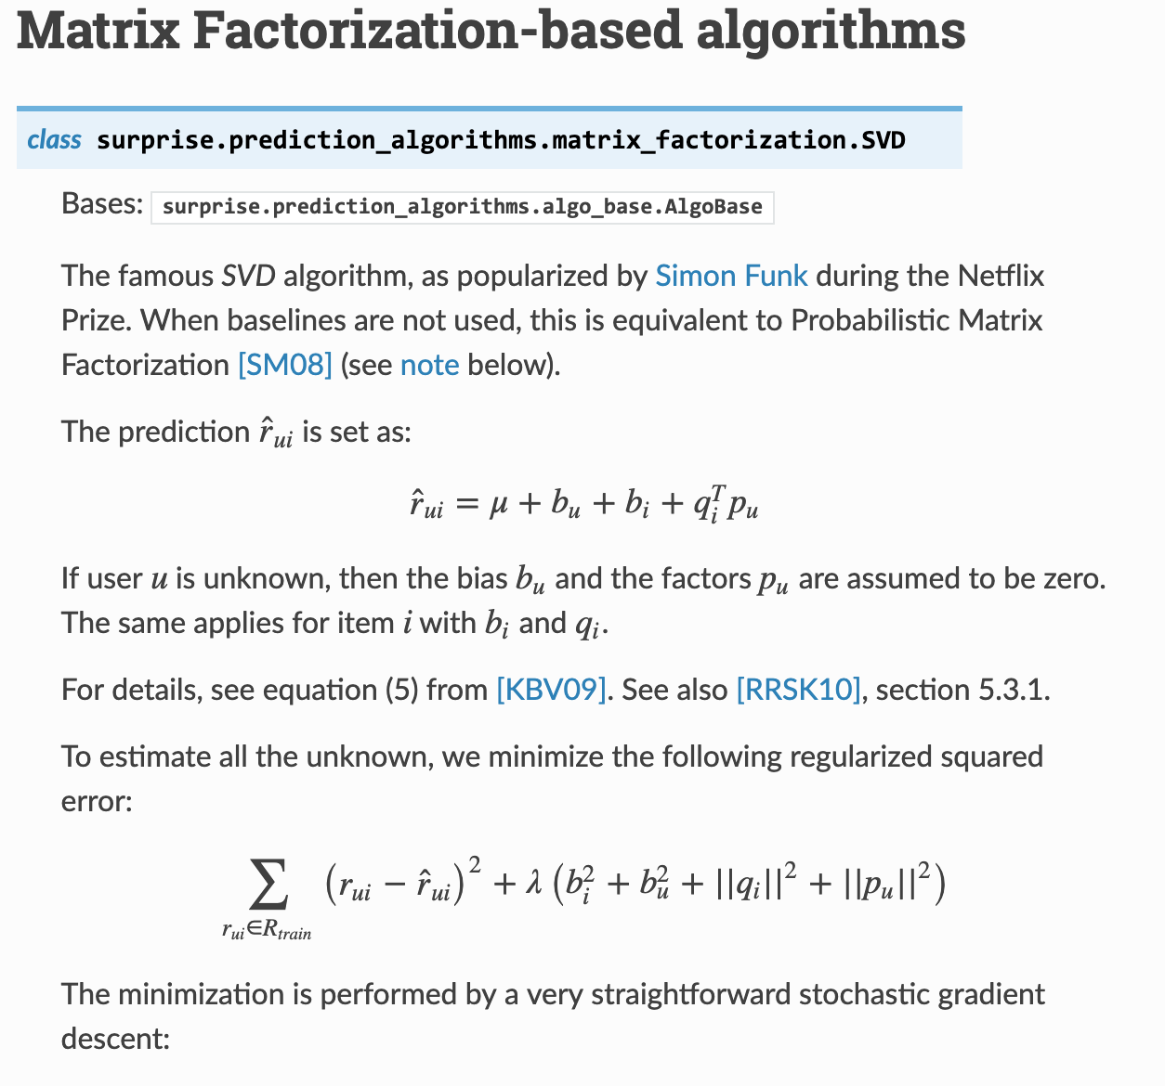
SVD/SVD++ https://surprise.readthedocs.io/en/stable/matrix_factorization.html
Matrix Factorization Based
https://en.wikipedia.org/wiki/Singular_value_decomposition#/media/File:Singular_value_decomposition_visualisation.svg

Slide 35
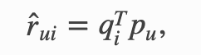
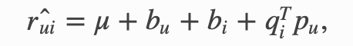
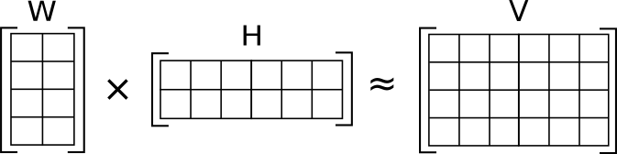
NMF https://surprise.readthedocs.io/en/stable/matrix_factorization.html
Matrix Factorization Based
Similar to SVD except user and item factors are always positive

Slide 36
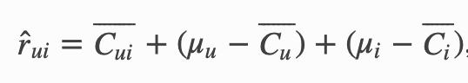
Co Clustering https://surprise.readthedocs.io/en/stable/co_clustering.html
Users and items are assigned some clusters and some co-clusters
Clusters are assigned using straightforward optimizatioin method just like kmeans

Slide 37
Nearest Neighbor
Similar users or similar items
User based filtering - find user with similar item taste
Item based filtering - find item similar to item user bought

Slide 38
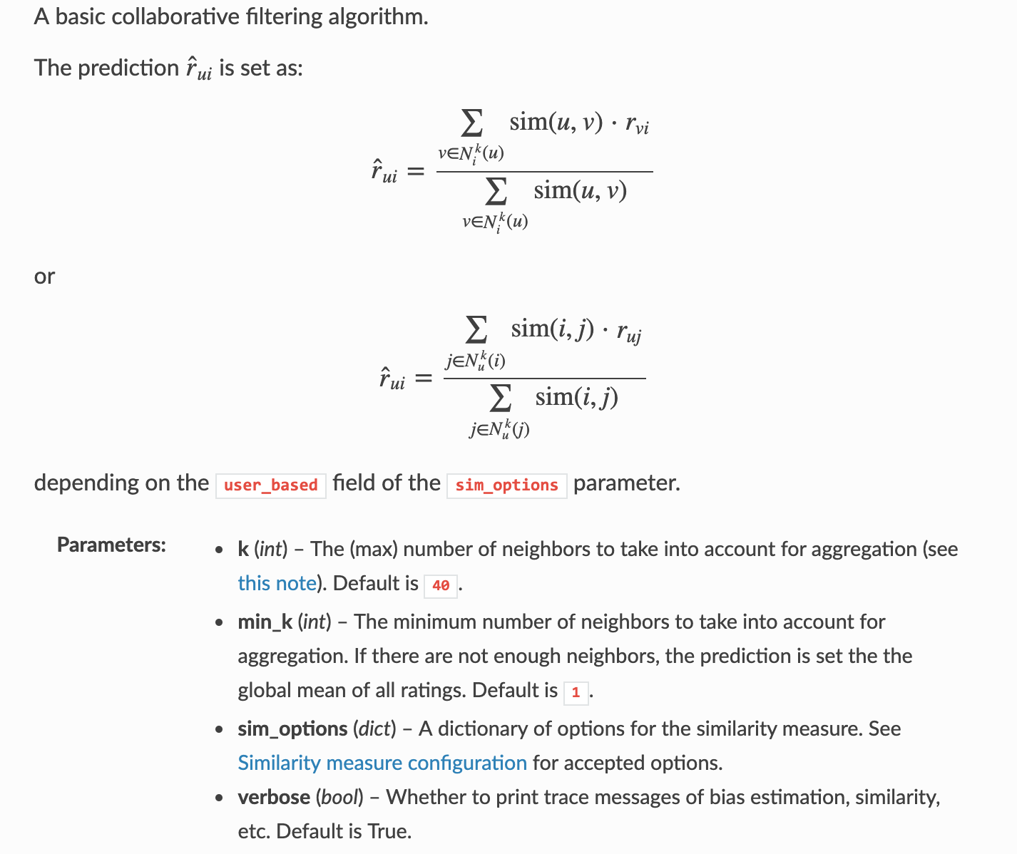
K-Nearest Neighbor
Similarity between users
Similarity between items
https://surprise.readthedocs.io/en/stable/knn_inspired.html

Slide 39
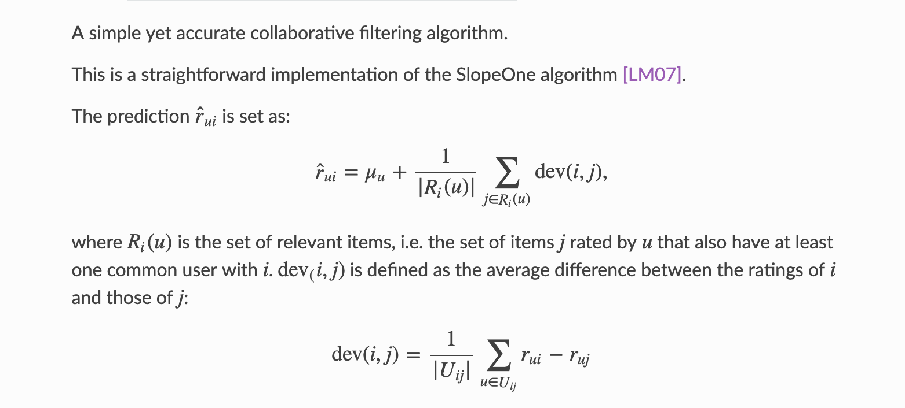
Slope One
where
https://surprise.readthedocs.io/en/stable/slope_one.html

Slide 40
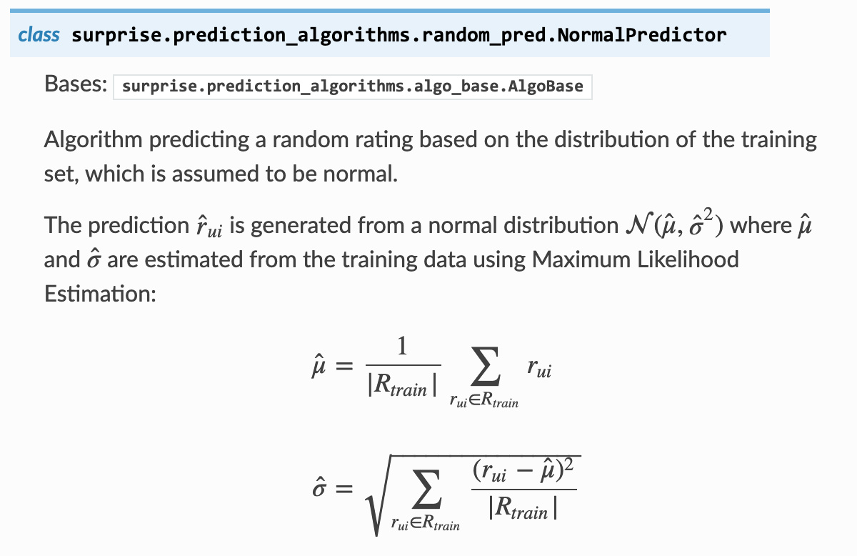
Normal Predictor https://surprise.readthedocs.io/en/stable/basic_algorithms.html
Assume the distribution of training set is normal
where
The prediction is generated from the normal distribution
Using maximum likelihood

Slide 41
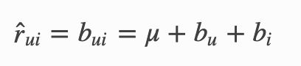
Baseline
Given user and item
If user u is unknown, then the bias is assumed to be zero. The same applies for item i with
https://surprise.readthedocs.io/en/stable/prediction_algorithms.html#baseline-estimates-configuration
https://surprise.readthedocs.io/en/stable/basic_algorithms.html
Notes:
https://surprise.readthedocs.io/en/stable/prediction_algorithms.html#baseline-estimates-configuration
https://surprise.readthedocs.io/en/stable/basic_algorithms.html

Slide 42
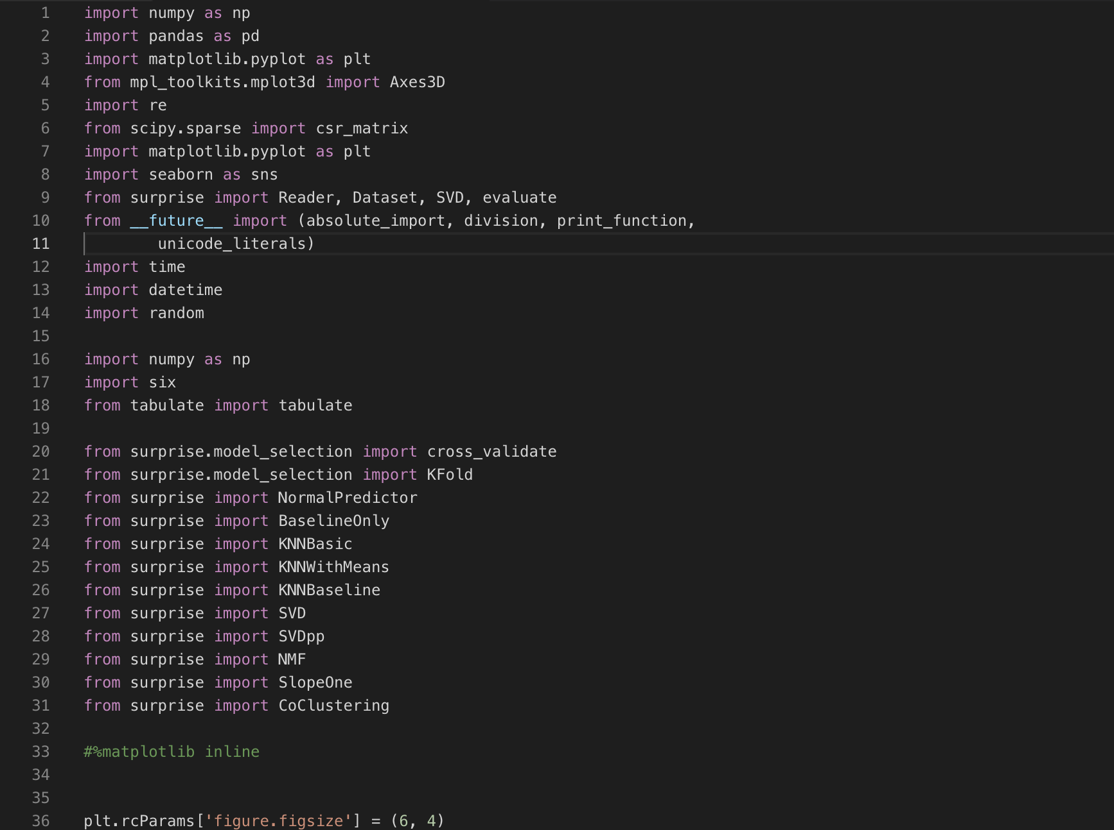
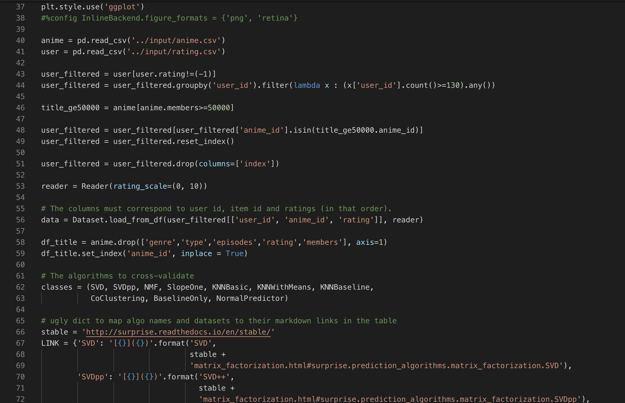
Python Implementation

Slide 43
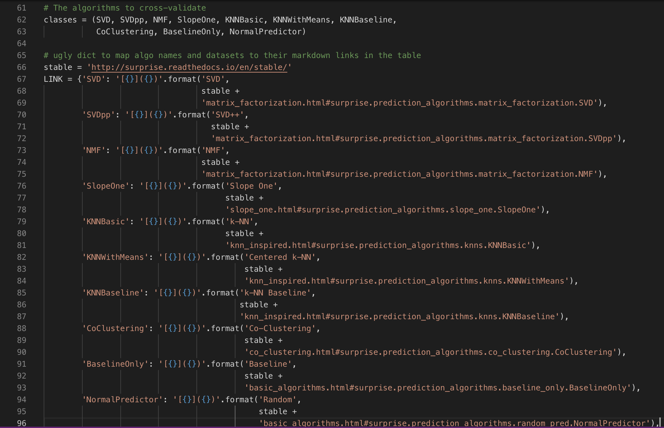
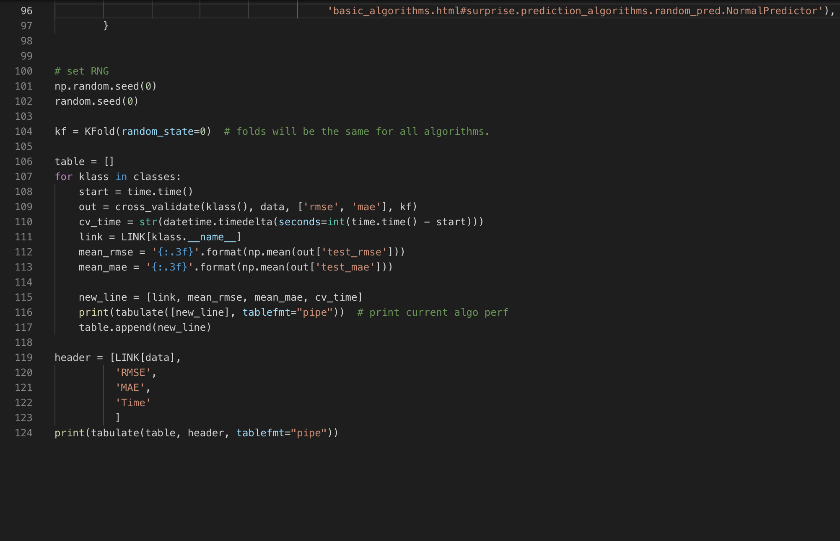
Python Implementation

Slide 44
Python Implementation

Slide 45
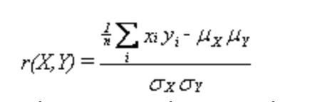
Pearson

Slide 46
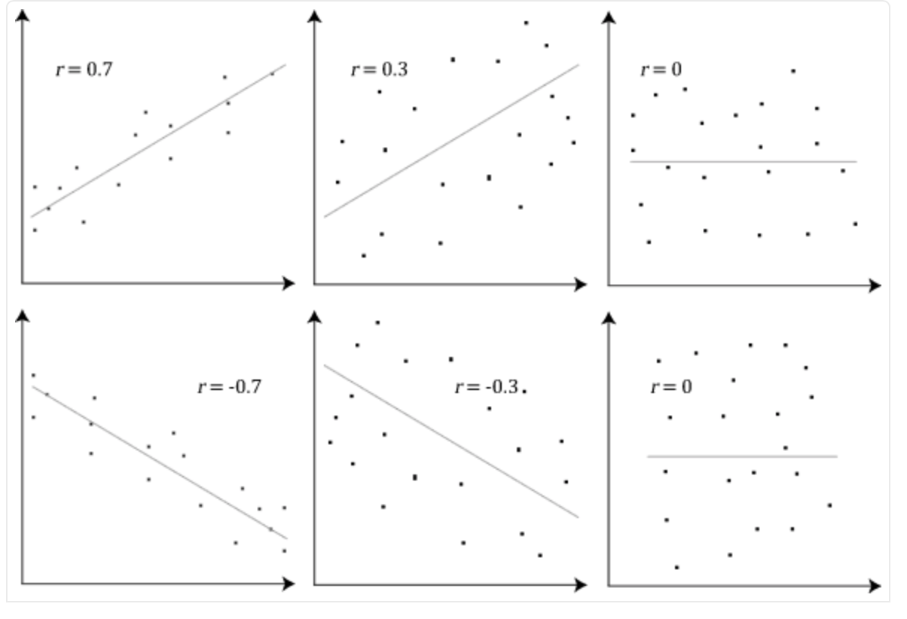
Pearson

Slide 47
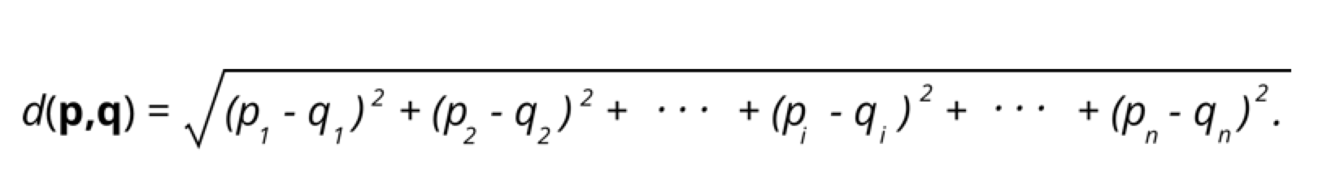
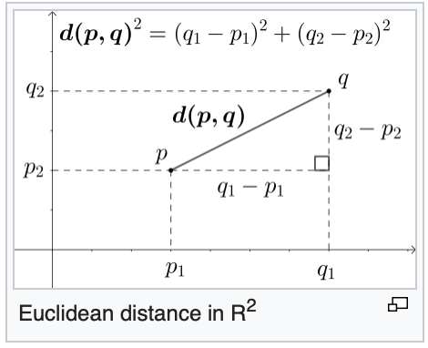
Euclidean

Slide 48
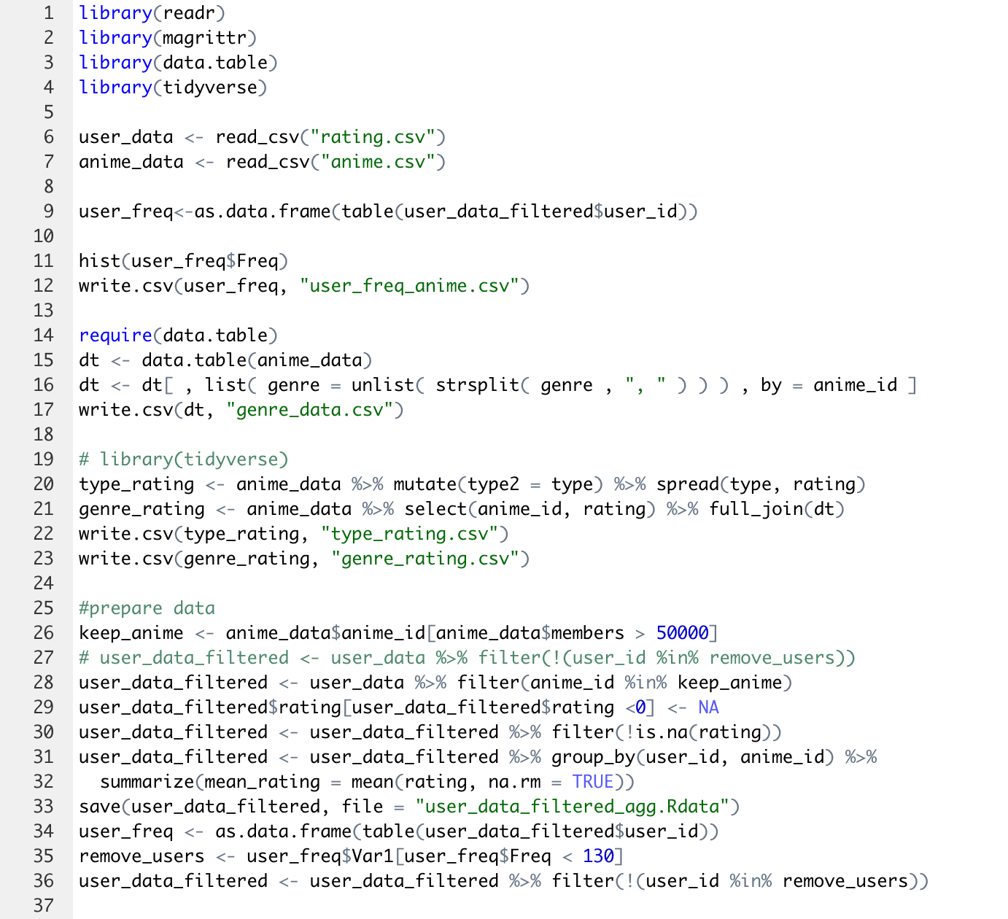
R Implementation - Data Filtering (1)

Slide 49
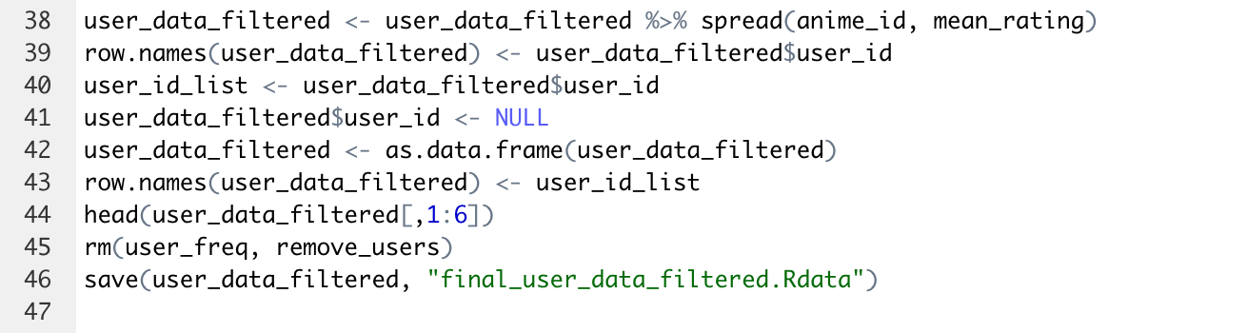
R Implementation - Data Filtering (2)

Slide 50
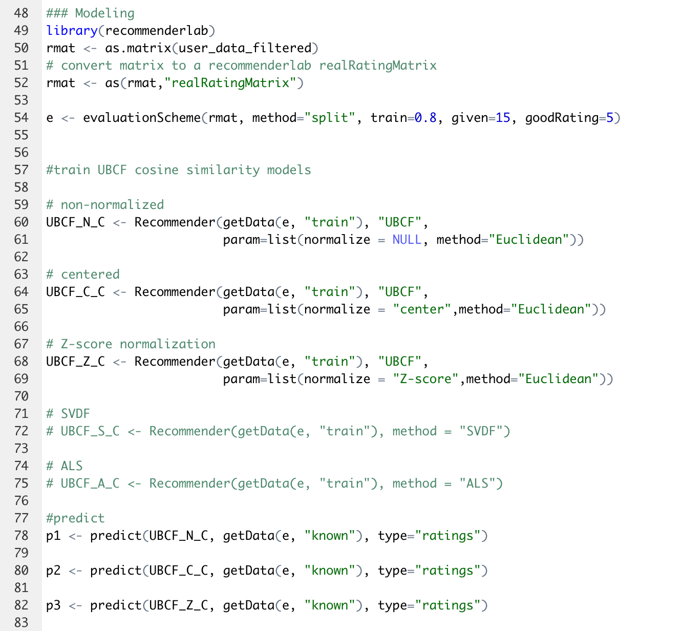
R Implementation - Modeling (1)

Slide 51
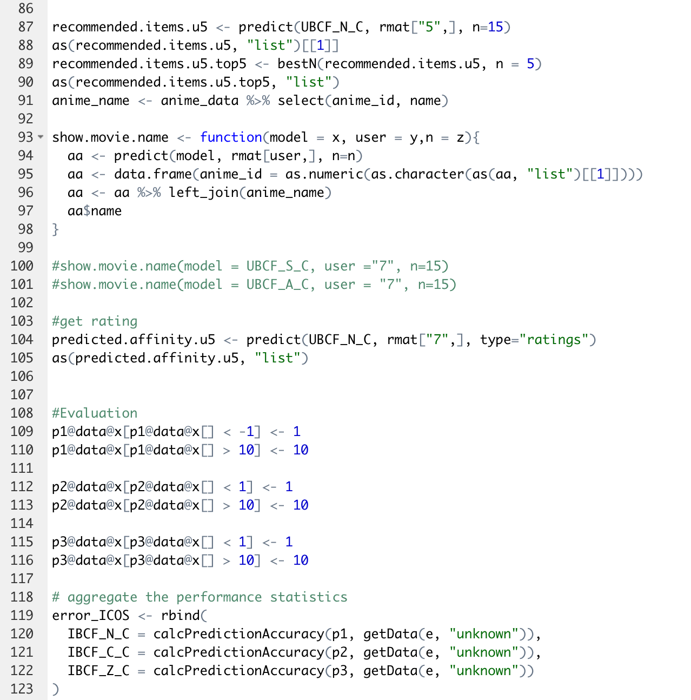
R Implementation - Modeling (2)

Slide 52
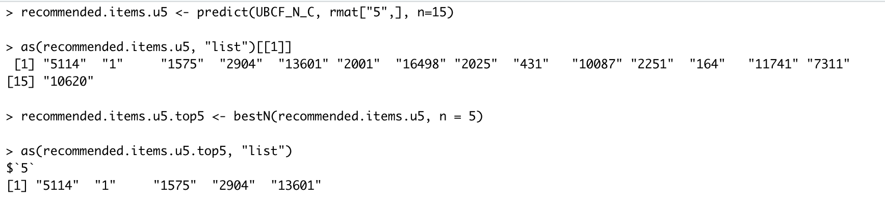
R Implementation - Pearson Results (1)

Slide 53
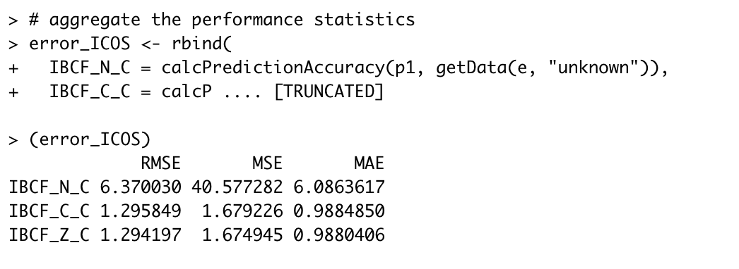
R Implementation - Pearson Results (2)

Slide 54
R Implementation - Euclidean Results (3)

Slide 55
R Implementation - Euclidean Results (4)

Slide 56
Results
Benchmark*
Algorithm | RMSE | MAE | Runtime (hour)
SVD | 1.065 | 0.798 | 0:09:41
NMF | 2.884 | 2.672 | 0:10:07
Slope One | 1.148 | 0.868 | 0:07:26
k-NN Basic | 1.135 | 0.849 | 2:05:32
Centered k-NN | 1.128 | 0.856 | 2:06:43
k-NN Baseline | 1.113 | 0.840 | 2:08:23
Co-Clustering | 1.138 | 0.863 | 0:04:55
Baseline | 1.153 | 0.875 | 0:01:23
Random | 2.045 | 1.621 | 0:00:56
*Run on a PC with Intel Core i5 7th gen (2.5 GHz), 8G RAM, and GPU: GTX 1070ti

Slide 57


Prediction from SVD algorithm of
the top ten recommended anime for user_id = 1

Slide 58
Conclusion and Future work
Data visualization
Data cleaning
Model selection
Benchmark
Best RMSE : SVD
Best MAE : SVD
Cooperate more available data
Type: movie, TV, OVA, etc.
Number of episodes
Implicit user data
Watch but unrate

Slide 59
Acknowledgement
We would like to thank Professor Gu for providing us BIG knowledge on this Big Data class. Without her, we simply would not be able to complete this project and learn so much in such a small period of time.
We are thankful for Mek and Yai, our Thai friends who gave us advices throughout the project. Without them, we would not be able to accomplish this much in the project.
We also want to thank Chelsea and Alireza for listening to our project and taking the class with us. Without them, we would be lonely and have less fun in the class.

Slide 60
Q&A

